Slide 1





Tim Bary
Marko Jovanovic
Conrad Kummeler
Andru Onciul
25/03/2022

Slide 2
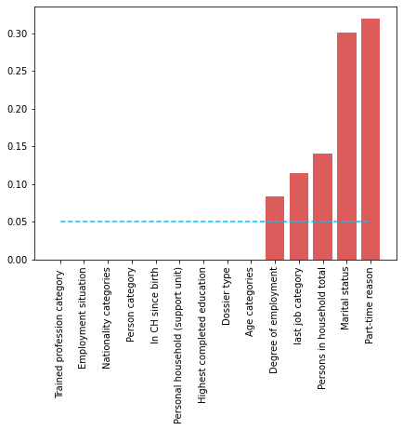
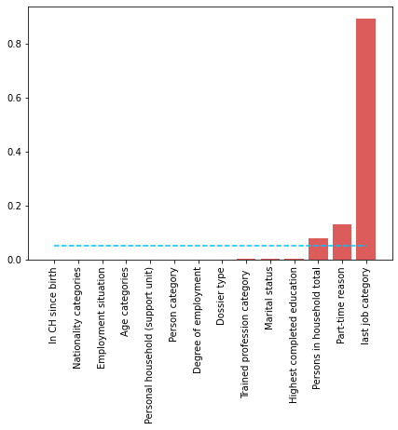
Data Mining – Features
Chi squared
ANOVA
Last job category
Part-time reason
Persons in houshold
Marital status
Degree of employment

Slide 3
Data Mining – Archetypes
Algorithm used : K-modes
Christian
Marek
Saba
Liam
Lou
Single parent
with children
European
young adult,
no formation, never worked in CH
Mom of African family,
no formation,
never worked in CH
Swiss
young adult,
no work,
formed
Swiss
young adult, unable to work
All those people do not have a work and are under the age of 45

Slide 4
Data Mining – Classifier
Our classifier has an accuracy of…
65%
…It basically predicts almost all the time that the person is not reimbursing
Why is it so ?
Just look at these statistics :
Status
Proportion
Being Helped | 31 %
Help finished | 63 %
Reimbursing | 2.2 %
Reimbursment finished | 3.4 %
We need to find a way to retrieve the money money while keeping a system based on honesty
Notes:
Good news : the pipeline is ready to classify as soon as it will receive proper data
Bad news : the target values are so unequal that it is impossible to have predictions

Slide 5
Why create engagement?
Engaged group helping on its own initiative
Personal (emotional) involvement in the community
Feeling of belonging and purpose
Offer to others the same opportunities you were given
Paying back…
Impersonal system that helps you by obligation
No sense of moral accountability
To the city
To the community

Slide 6
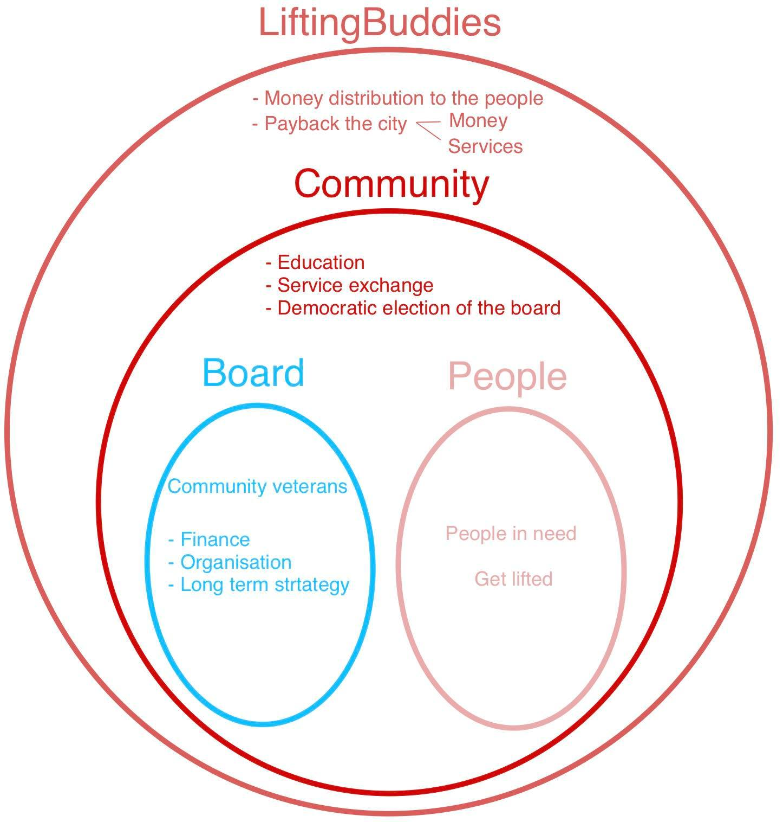

Slide 7
Ecosystem
LiftingBuddies
Money
City
Services
Services
Money
Services
People
Money

Slide 8
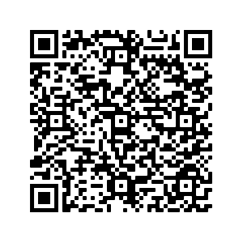
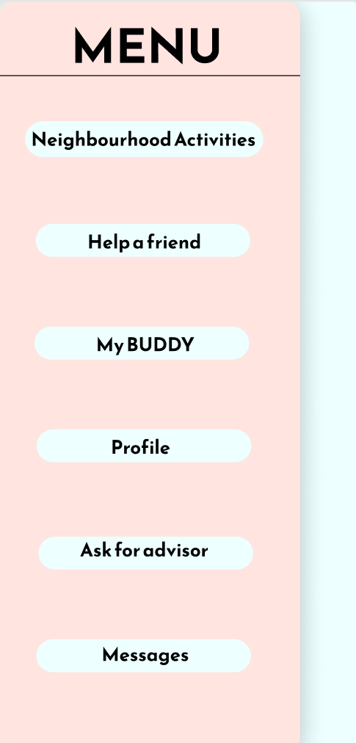
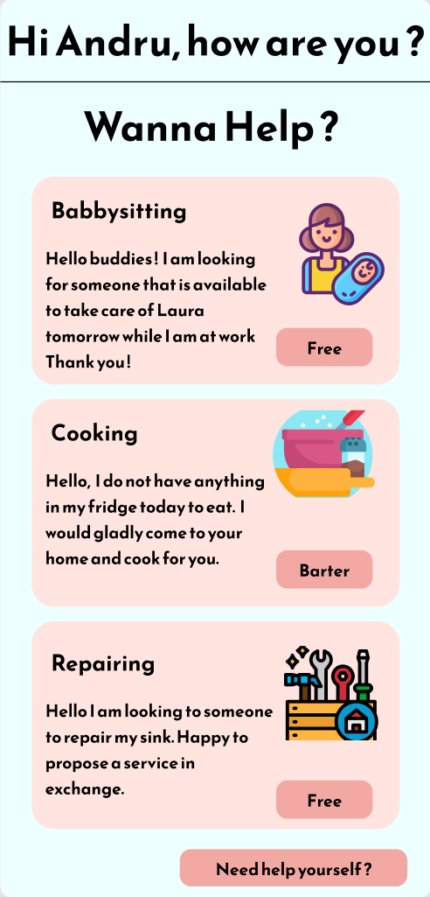

Mock-up

Slide 9

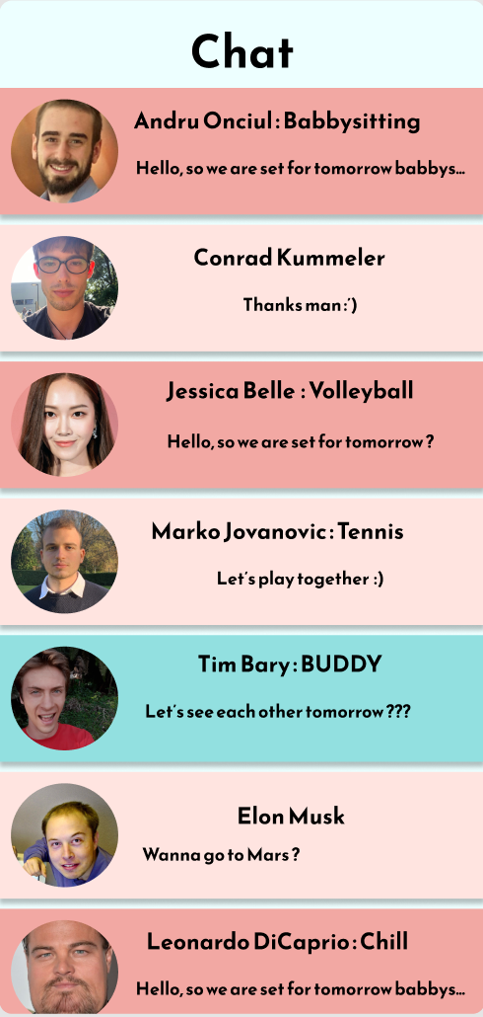
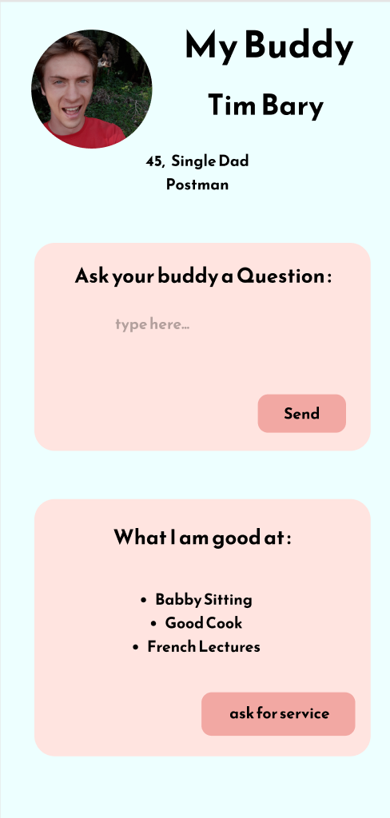
Mock-up

Slide 10
How to start the machine
Financial aid from the city
After a couples of year, the first help seekers become autonomous
First generation of benevolants
Developing the social reinsertion program with the benevolants
The benevolents help the community
grow and become autonomous
Progressive decrease of the city subsidies
Notes:
Creating the community
Electing the first board of benevolent
Decreasing progresively the subsidies
The community becomes autonomous
Decreasing the social subsidies to a minimal threshold

Slide 11

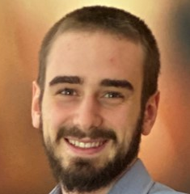
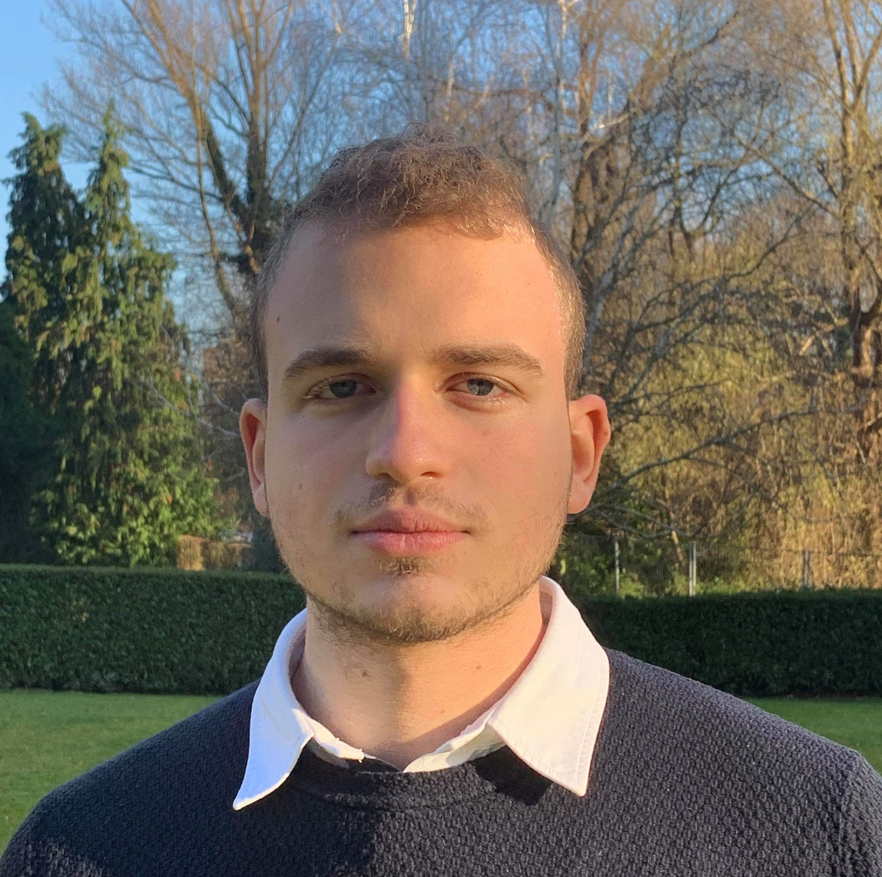

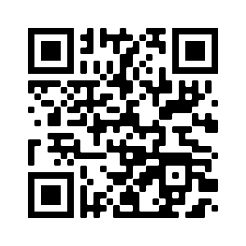

Thanks for your attention
Data mining
Ecosystem
Engagement
Tim
Andru
Marko
Conrad
Code, slides, free cookies…

